Slide 1
Stack path server density
→AWS Monitoring Tool

Slide 2
Stack path
StackPath is an edge computing platform that provides both infrastructure as a service and applications, running closer to end-users and devices than the same solutions from hyper-scale, core cloud providers.
StackPath is a top notch complete edge computing platform, providing infrastructure and applications that are physically closer to end users than traditional, centralized cloud computing offerings. They offer infrastructure as a service including Virtual Machines, Containers and storage and advanced delivery and security services including CDN and WAF.

Slide 3
Advantages
Intelligent Caching
Customize Caching with rules
Instant Purge to remove content from the cache
Easy to Manage

Slide 4
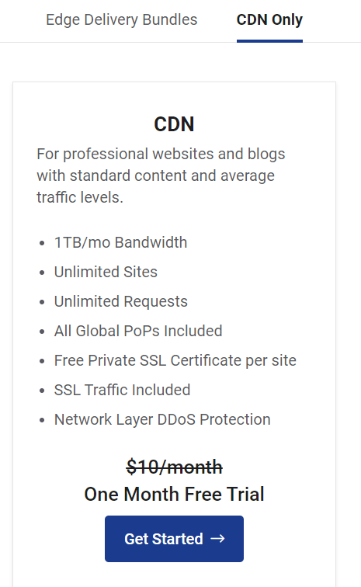
Stack path pricing
CDN only→ 1st 1 month free trial
This plan is basically for CDN services only.
This plan works great with standard content
and average traffic levels.
Edge Delivery Bundles→1st 1 month free trial
→Edge Delivery 20: $20/month
→Edge Delivery 200: $200/month
→Edge Delivery 2000: $2000/month

Slide 5
Server density
Server Density enables users to monitor their websites and servers in the cloud or on-prem from a single console and API to easily diagnose problems, maintain uptime, and maximize server performance.
The Server Density platform supports Amazon CloudWatch and also offers a range of additional plugins relevant to AWS users.
→AWS ELB Server Density Plugin
→AWS RDS Server Density plugin

Slide 6
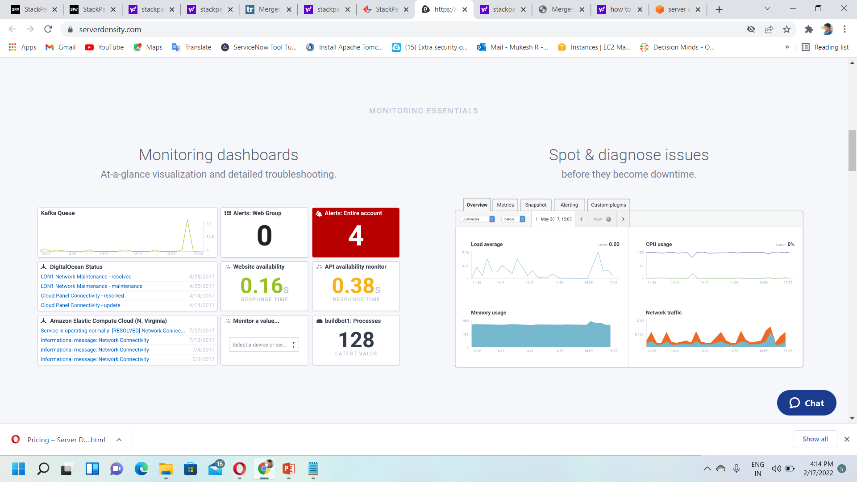
Monitoring essentials

Slide 7
Advantages
A flexible cloud-based monitoring solution
Covers both hardware and networking monitoring
Alerting templates fit virtually any notification platform you wish to integrate
MONITORING ALERTS
Alert on any metric, Docker & Kubernetes and container monitoring, Process monitoring, Automated alert management.

Slide 8
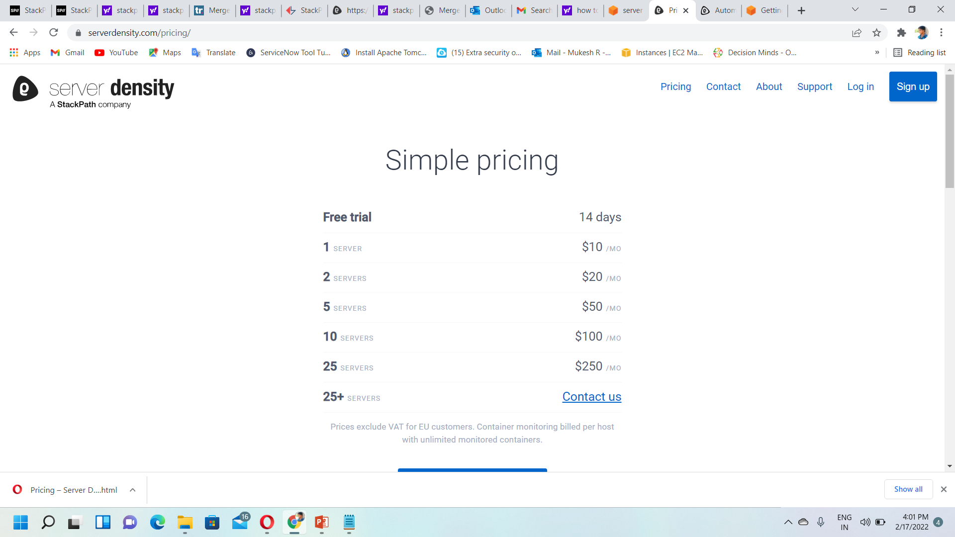
Pricing plans→
What are the things server density have?
→The server density monitoring agent is installed on millions of servers, and collects more than 12 billion metrics each day. The service has more than 100 official integrations, processes more than 300TB of data per month, and has availability probes in more than 28 different geographies.

Slide 9
Stack path server density merge
Dallas TX, May 14, 2018 — Server Density, a provider of proactive infrastructure monitoring for cloud, servers, and websites, is merging with StackPath, a leading secure edge services platform provider. Server Density enables users to monitor their websites and servers in the cloud or on-prem from a single console and API to easily diagnose problems, maintain uptime and maximize server performance. The service will be integrated and offered as part of the StackPath platform in the very near future.
StackPath has the highest commitment to providing our customers frictionless services, complete visibility into their solutions, and building strong relationships with the open source community and the industry at large. Server Density has followed the same commitments as it built exceptional technologies that are second to none and grew operations at cloud scale.

Slide 10
Thank you

